Slide 1
Week 1
Introduction to Data Design

Slide 2






Matthew Bebis

Slide 3




















Slide 4



Chewbacca

Slide 5
Class Expectations
Ask questions if you are confused
Try not to distract your classmates
During lessons, use technology only for legitimate class activities (note-taking, assigned tasks)
Participate when asked

Slide 6
Instructor Expectations
What do you expect from me?

Slide 7
This Week
Introduction to Data Design
Lab 1 (5%)

Slide 8
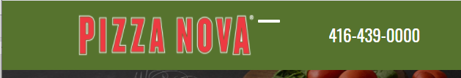
The Need for Data Design
To understand what and why we want to create software
To build a movie website, information above movies should be defined first
By defining data needed first, we gain the ability to make future decisions about how to build/design our software
Data
Raw values
4164390000
Information
Data with context
416-439-0000
Knowledge
Ability to make decisions

Slide 9
What is Data?
Data is a collection of information
An individual piece of information is a ‘datum’
Datum is the singular form of data
Every application utilizes data in some way and that data usually needs to be stored somewhere
Databases are the solution for storing data

Slide 10
What is a Database?
A database is a structured way to store data
Databases are systems used to access, manage, and update data
There are many types of databases, each structuring data in specific formats
One of the most common is the relational database
Relational DBs (databases) are also the main focus of this course

Slide 11
Relational Databases
Relational databases hold tables
Tables store data in rows and columns (Just like a spreadsheet!)
Tables within a database may hold related data, hence why these databases are relational
24F-HumberWebDev-DB
Students
Assessments
Courses
Student_ID
First Name
Last Name
Grade
Title
Student_ID
Course_ID
Course_ID
Name
Instructor
Database
Tables

Slide 12
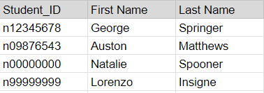
Tables
Tables should represent an object, subject, or concept
Each column represents an individual data property of the object
Ex: a student table would have a student ID and a name
Students
Student_ID
First Name
Last Name
Each row represents an individual instance of that represented object
Ex: an individual student would have an id “n12345678” and name “George Springer”

Slide 13
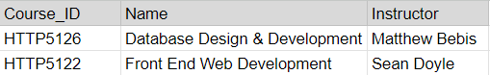
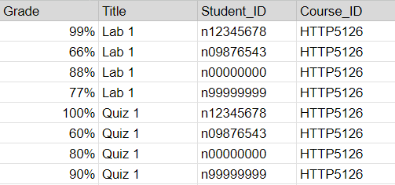
Relational Databases
Example
24F-HumberWebDev-DB
Students
Assessments
Courses
Student_ID
First Name
Last Name
Grade
Title
Student_ID
Course_ID
Course_ID
Name
Instructor

Slide 14
Relational Databases Summary
Databases hold Tables
Tables hold pieces of Data about a single subject
Relational Databases allow Tables to connect (relate) to each other to each other
24F-HumberWebDev-DB
Data Subjects
Students
Assessments
Courses
Student_ID
First Name
Last Name
Grade
Title
Student_ID
Course_ID
Course_ID
Name
Instructor
Database
(Relational)
Link between tables
Link between tables
Tables

Slide 15
Designing Databases (Ex. Social Media)
What data do we need to show the user?
How can we organize the data?
What data relates to a single object, subject, or context?
What data is connected?

Slide 16
Week 1 Terminology
Data: a collection of information for reference or analysis
Datum: An individual data value
Datum is the singular form of data
Database (DB): Organized collection of structured information (data)
DB is an acronym from the original "data base", this acronym is common in com-sci field
Relational Database: Organized collection data of one or more tables. Tables are related through shared fields.
Tables: Data stored in columns and rows. Spreadsheets are an example of a table, but a spreadsheet is NOT a database.
Tables should represent a single subject that may have multiple properties
Columns: 1 property of the subject stored in a table
Rows: 1 instance of the subject stored in a table

Slide 17
Next Week
Introduction to SQL
Accessing Data
Lab 2 (5%)

